Slide 1
NASA RASC-AL Lunar Habitat
Midpoint Presentation
Aidan O’Brien, Salar Golshan, Jelani Peay, Ryan Navarette, Keerthi Nagaruri

Slide 2
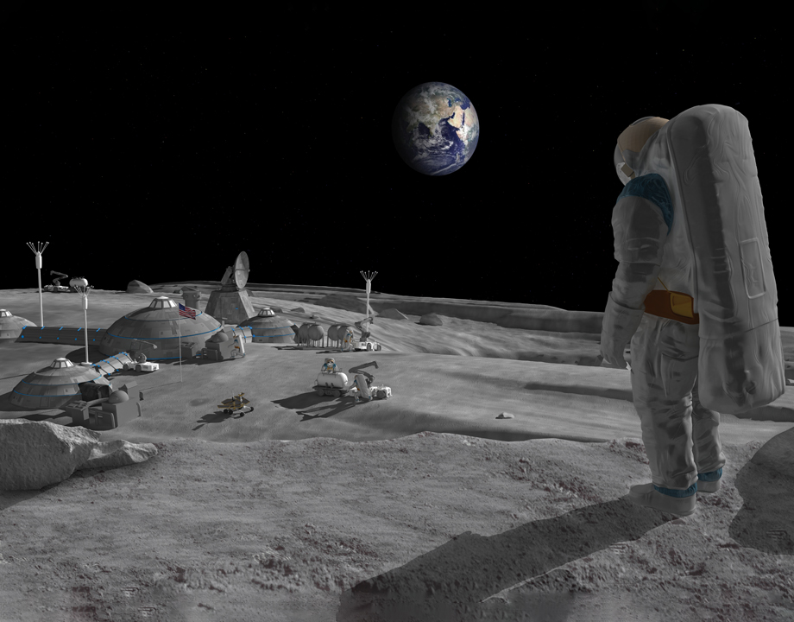

PROJECT Description
NASA’s Artemis mission will land the first man and woman on the moon in 2024. The team is tasked to design a low-mass habitat that can support 2 astronauts at the lunar south pole for 30 days.
  Design Constraints:
    Mass limit of 6000kg
    Theoretical NASA budget of $1 billion per year from 2022-2028
    Ready for first use in 2028
Figure 1: Habitat concept from Purdue [1]
Salar

Slide 3
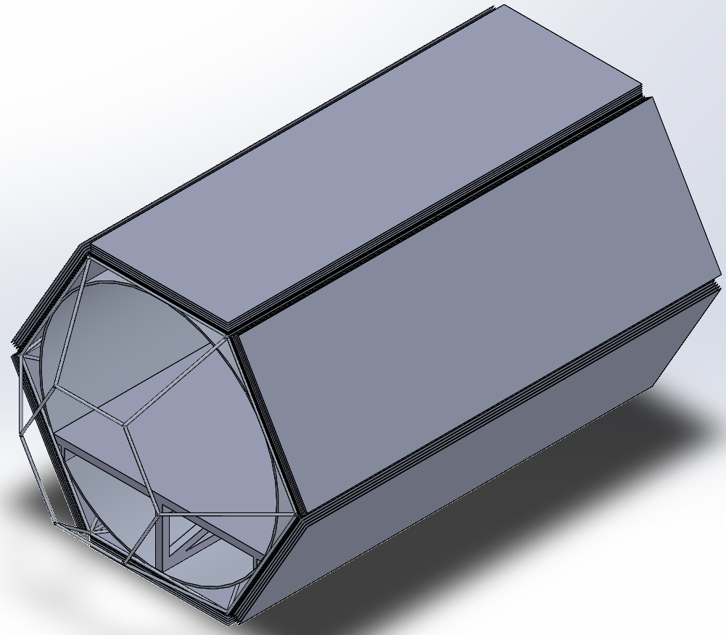

Design Description
The current lunar habitat design consists of multiple subsystems which include:
  Bone structure
  Pressure Wall
  Radiation Protection (MLI)
  Micrometeorite Protection (Whipple Shield)
  Window (Frame)
To be include:
  Air Lock
  Life Support Systems
  Legs
The current habitat is designed to be:
  Transported in a SpaceX Falcon 9 rocket
  Low mass: ~4000 kg
  Enough livable space for 2 astronauts for 30 days: ~40 m^3 (excluding storage space)
Figure 2: Current CAD model
Ryan

Slide 4
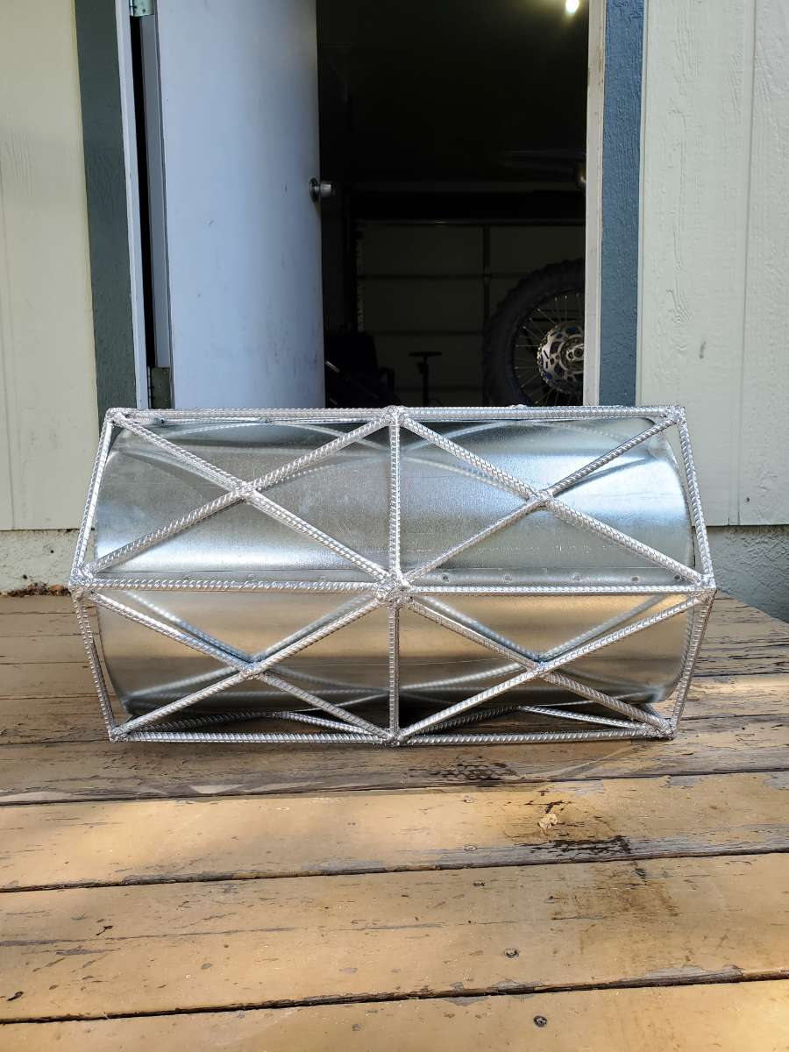
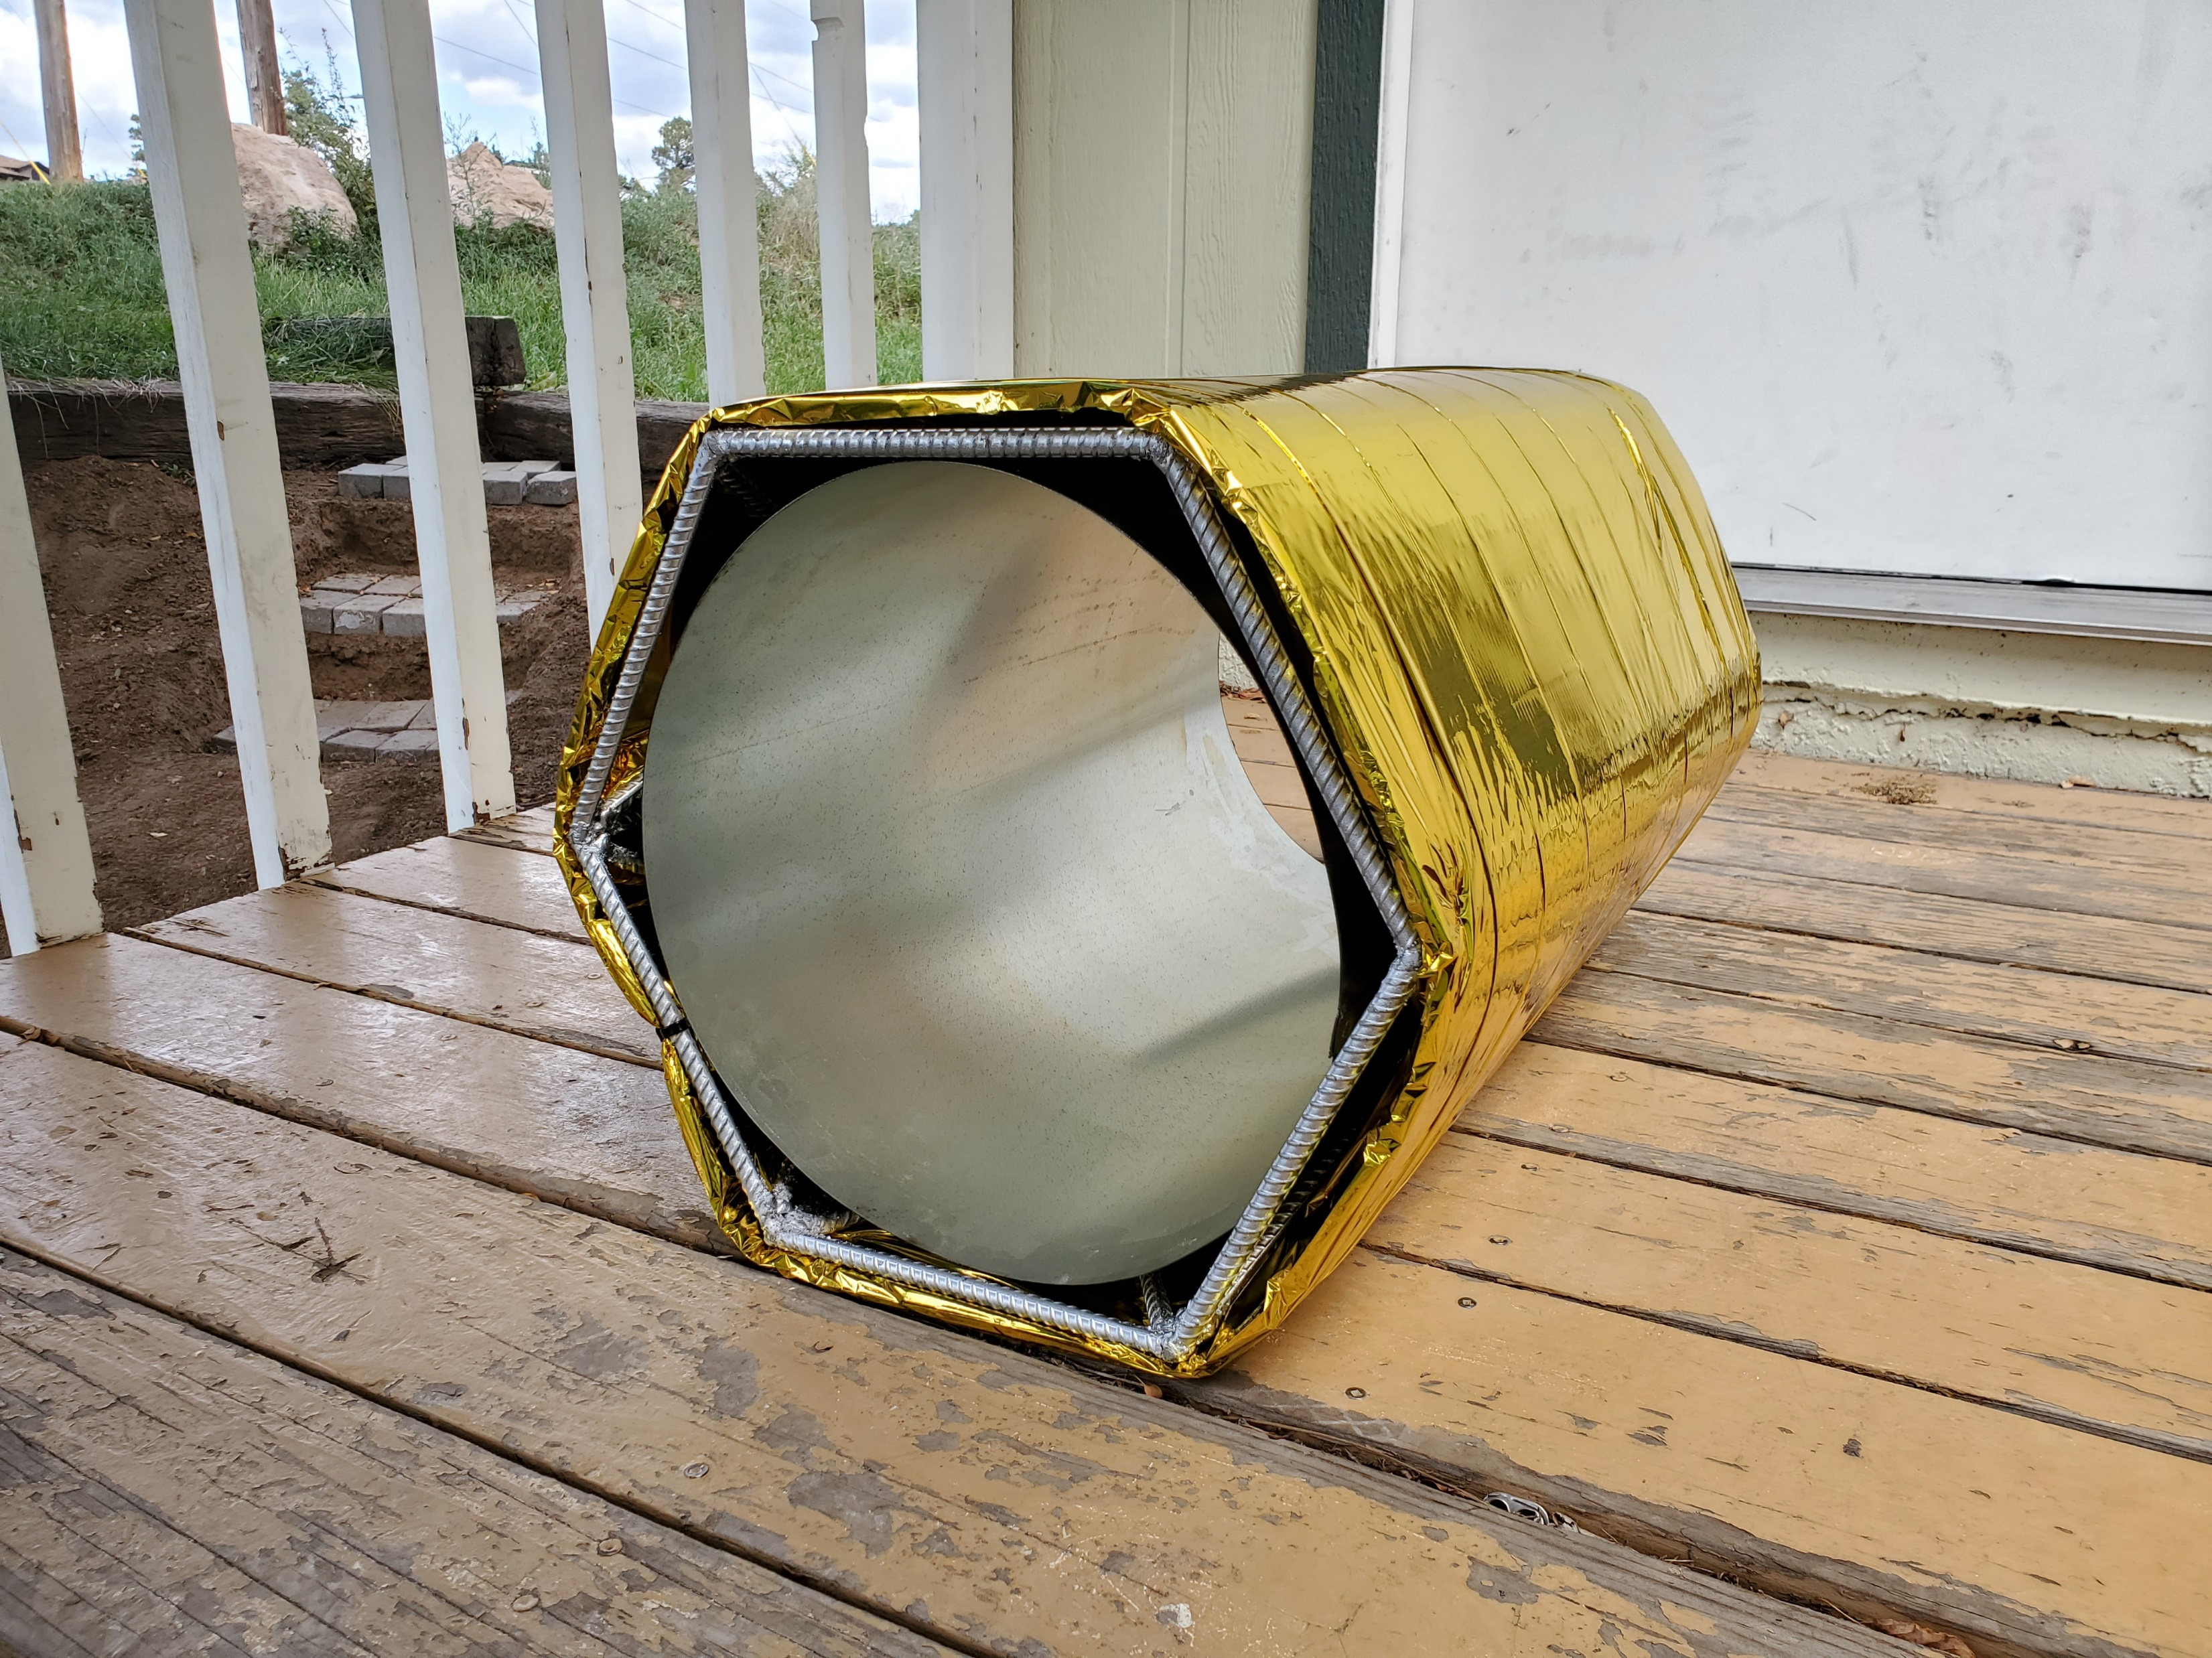
Prototyping - Current State of System
The current habitat prototype is built at 1/10th scale. Current finished subsystems are listed as follows:
  Bone structure (#3 3/8” Rebar)
  Pressure wall (24 Gauge Galv. Sheet Metal)
  Multi-Layer Insulation (DRI & Aluminized Mylar)
The subsystems that are still in progress of being constructed are listed below:
  Legs
  Floor (currently being printed)
  Whipple Shield (stock purchased and cut)
  Window
  Air-Lock
Figure 4: Current State of Prototype with MLI installed
Figure 3: Bone Structure and Pressure Wall
Aidan

Slide 5
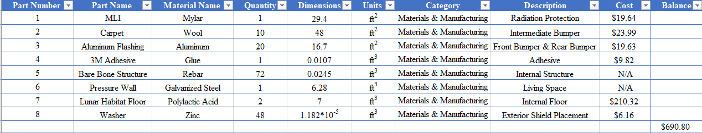
Prototyping - Current State of System: BOM
Table 1: Prototype BOM
Jelani

Slide 6
Prototyping– Current State of System
Steps for Prototype Completion
Bare Bone Structure Welding (Aidan)
Pressure Wall Assembly (Aidan)
MLI Purchase, Assembly, and Reassembly (Aidan & Jelani)
Whipple Shield Assembly (Aidan & Jelani)
Floor Purchase (Ryan & Keith)
Jelani

Slide 7
Analytical Analysis – Current State of System
Hypervelocity Impact Analysis
Figure 5: Front Bumper Impact Analysis
Figure 6: Rear Bumper Impact Analysis
Jelani

Slide 8
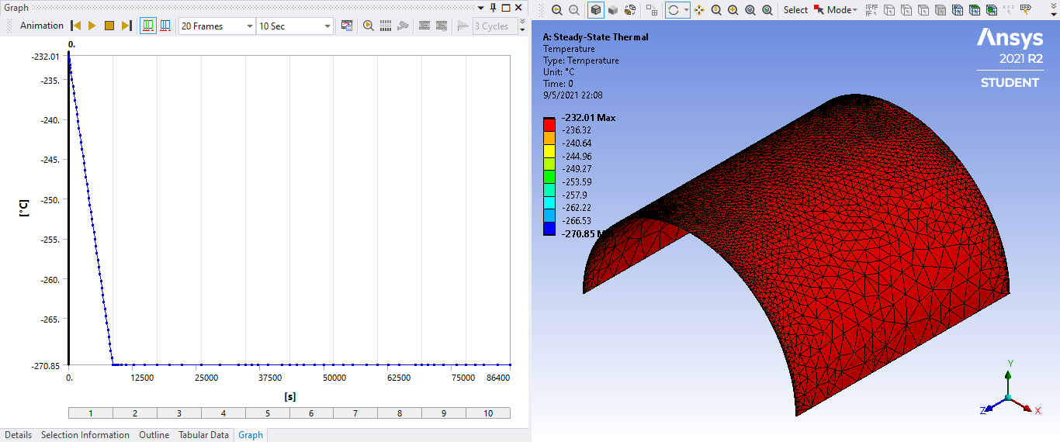
Analytical Analysis – Current State of System
Thermal Analysis: Steady State
Figure 7: Whipple Shield Thermal Analysis
Jelani

Slide 9
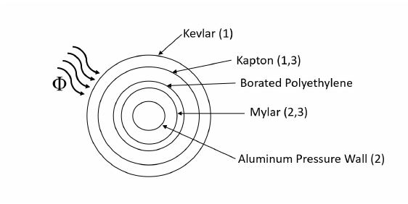


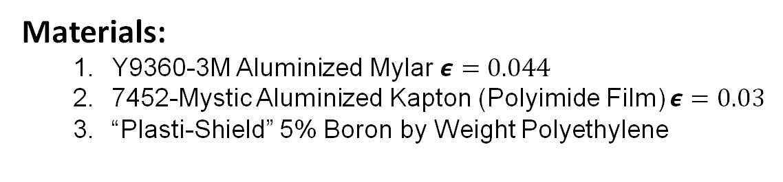
Analytical Analysis – Current State of System
Radiation Protection – MLI
  Astronauts exposed to:
    Electromagnetic Radiation (Most notably Infrared, Ultraviolet, Visible wavelengths)
    Neutron Radiation - Free flying neutrons (large fermions with no charge).
    1422 W/m^2 radiation flux
Materials:
  Y9360-3M Aluminized Mylar $ε=0.044$
  7452-Mystic Aluminized Kapton (Polyimide Film) $ε=0.03$
  “Plasti-Shield” 5% Boron by Weight Polyethylene
Figure 8: MLI Radiation H.T Diagram[2]
Aidan

Slide 10
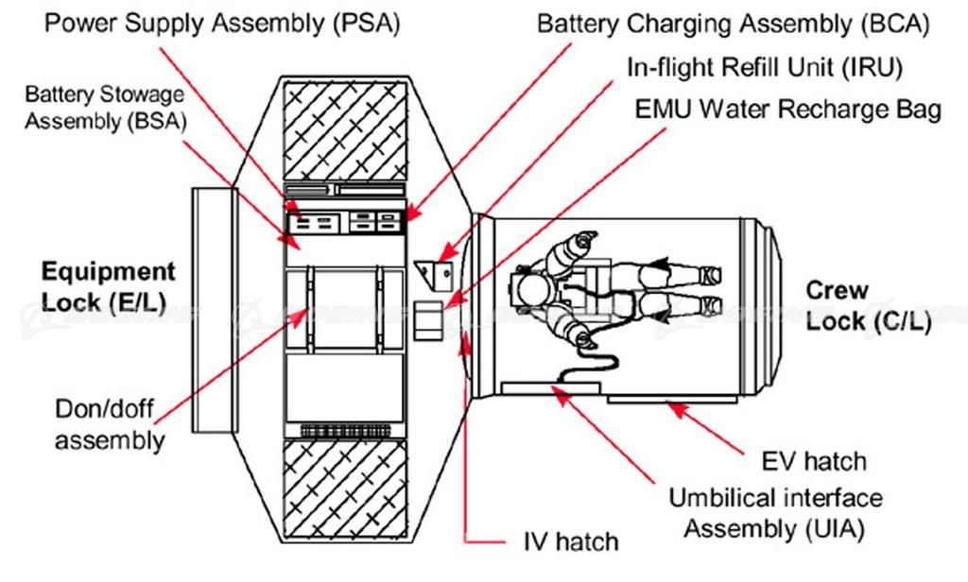
Analytical Analysis – Current state of System
Air Lock Mechanism
Sought after the Airlock Quest Model
Two separate compartments
  Crew Lock
  Equipment Lock
When leaving, crew airlock will trickle down to 3psi then to 0 psi- ensuring a slow adjustment
Will take up 2 meters of the habitat inside.
Around $160 Million design
Quest Airlock Diagram [3]
Salar

Slide 11
Manufacturing Implementation Plan 10/11-11/22
Table 2: Implementation Plan
Week | Team Members | Manufacturing Task
10/11-10/18 | Aidan, Jelani, Ryan | Finish printing and assemble floor and assembly of Whipple shield
10/18-10/25 | Salar, Aidan, Jelani | Begin construction of airlock and window. Complete any necessary purchasing.
10/25-11/1 | Ryan, Keith | Begin construction of legs. Complete any necessary purchasing.
11/1-11/8 | Salar, Aidan, Jelani | Finish construction of airlock and window, begin internals construction.
11/8-11/15 | Salar, Aidan | Finish internals construction.
11/15-11/22 | All team | Extra touchups and last-minute changes.
Aidan

Slide 12
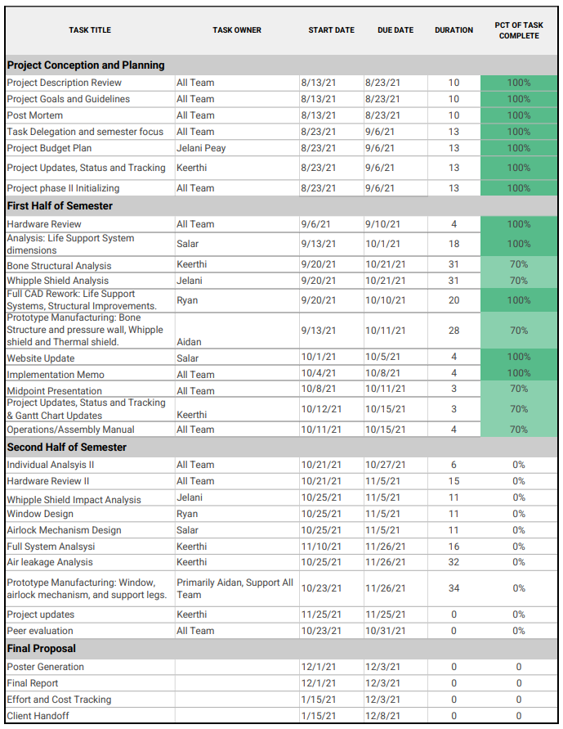
Full Schedule Implementation Plan
Major Datelines
Sub-System Analysis due 11/05/2021
Full Scale Analysis due 11/26/2021
Prototype Build due 11/26/2021
Minor changes and updates to the model 12/01/2021
Final Report, Product and Poster 12/03/2021
Client Handoff 12/08/2021
Keith
Notes:
Full Schedule Implementation Plan.
This section talks about the full schedule implementation plan which includes
the analysis required for the final design. The first half of the semester was focused
on the life support system dimensions, whipple shield analysis and bone structure
improvements.
The second section involves the whipple impact analysis, window and air lock design.
Completing these would conclude the Sub-System design changes due Nov 5th and begin the full scale
analysis due Nov 26th.
This will be followed by minor changes and updates to the model and final report and poster that are due
beginning of December. This implementation plan will ensure successful final design and product
handoff on December 8th.

Slide 13
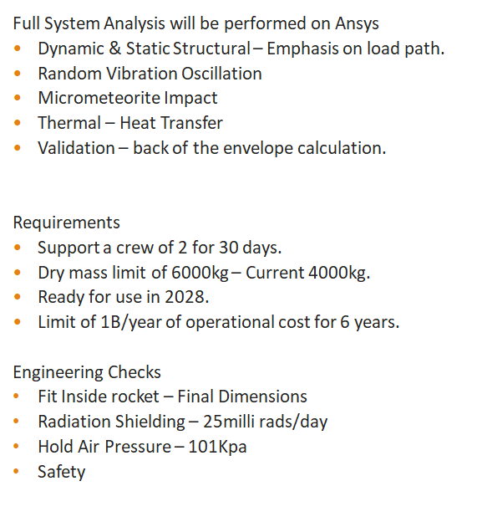
Testing Plan – Ansys Full System Analysis
Subsystem Analysis performed on
Bone Structure
Pressure Wall
Whipple Shield
Window
Air Lock
Keith
Notes:
Following the implementation plan, full model testing plan done in Ansys Workbench.
The subsystems that were analyzed included bone structure, pressure wall, whipple shield
window and airlock. The full-scale model will be built using these subsystem analysis, and will then be
tested to validate the design.
The team plans of testing the full-scale model for dynamic and static
structural analysis with an emphasis on the load path to handle the air pressure of 101KPa,
including vibration analysis for the travel leaving earth at an acceleration of 50m/s^2.
Micrometeorite impact test for deformation and stress concentrations, and final radiation shielding of
25millirads/day which would ensure a constant internal temperature as well as improve safety.
Although minor design changes might be needed to meet the full system requirements, the team believes
conducting these tests will ensure a safe journey for the astronauts.
Final requirements validation include checking dry mass limit of 6000Kg and a total living space of 50m^2
for human psychology factors and cost under 6 Billion.

Slide 14
References
[1] C. Kelly, “Lunar habitats must survive a worst-case environment.,” ASME, 23-Jul-2020. [Online]
[2] A. O'Brien, “NASA RASC-AL RADIATION SHIELDING INDIVIDUAL ANALYSIS,” Apr. 2021.
[3] R. Frost, "Quest Airlock on ISS" 2013 [online]

Slide 15
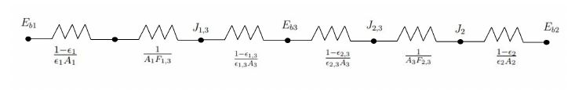


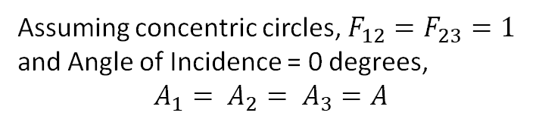
Appendix A – MLI Calculations
Figure A1: Thermal Radiosity Network
Assuming concentric circles, $F_{12}=F_{23}=1$ and Angle of Incidence = 0 degrees,
$$A_{1}= A_{2}= A_{3}=A$$
Aidan

